Slide 1


Grooming the Hairball - How to Tidy up Network Visualizations?
Hans-Jörg Schulz¹, Christophe Hurter²
VIS Tutorial 2013
University of Rostock, Rostock, Germany
Ecole Nationale de l’Aviation Civile, Toulouse, France

Slide 2
Part I: NODE SET SIMPLIFICATION
Speaker: Hans-Jörg Schulz

Slide 3
Node Set Simplification
Why simplify the Node Set?
Simplifies edge set at the same time
Compatible with subsequent simplification of the edge set
Simplifies even if no edges are given/drawn

Slide 4
Objectives
At the end of Part I, you will be able to explain:
the principles of detecting and reducing clutter by node set simplification
at least one example for each principle and the interactive means to steer it
Which simplification methods can be combined across data level, geometry level, and image level
Notes:
In this part of the tutorial, we will discuss algorithms and interactive
techniques to reduce edge clutter in visualizations. These techniques
mainly rely on edge-bundling algorithms which have been
subject to an increased interest in active research and a number of
improvements and enhancement in recent years.

Slide 5
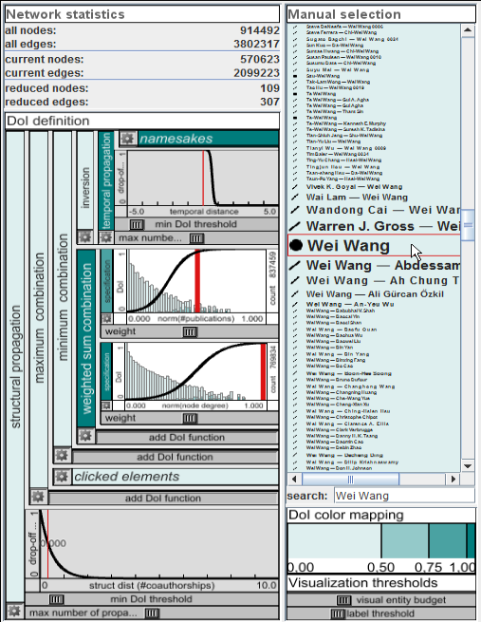
Data Level (Filtering)
Node Set Simplification on

Slide 6
Node Set Simplification on
Data Level (Filtering)
If a given network produces clutter, the only way to counter that on data level is by reducing the number of nodes. (or edges… cf. Part II)
There are two ways to perform such a reduction:
Indiscriminately – e.g., sampling
Selectively – e.g., filtering w.r.t. user interest
Focus

Slide 7
Indiscriminate Simplification on
Data Level (Filtering)
Most popular method: Traversal-based Sampling (as it maintains connectivity)
Breadth/Depth/Random First Sampling
Snow-Ball Sampling
Random Walk Sampling
…
Further reading on sampling: [Hu+Lau 2013] “A Survey and Taxonomy of Graph Sampling”

Slide 8
Selective Simplification on
Data Level (Filtering)
Challenge of the selective node set simplification: Find nodes that are expendable w.r.t. some given (or implied) criterion.
There are two kinds of expendable nodes:
Uninteresting nodes Cardinality: individual (single) nodes Example: singletons
Redundant nodes Cardinality: group of (multiple) nodes Example: similar nodes

Slide 9
Uninteresting Nodes on Degree-of-Interest Measures
Detecting
Data Level (Filtering)
The Traditional Monolithic DoI Specification
different DoI components:
a-priori interestingness [Furnas 1986]
distance to focus [Furnas 1986]
user interest [van Ham + Perer 2009]
navigation history [Gladisch et al. 2013]
Weighted Sum

Slide 10
Uninteresting Nodes on Degree-of-Interest Measures
Detecting
Data Level (Filtering)
A Modular Approach to DoI Specification
[Abello et al. 2014]
specification components = DoI generators providing the base DoI values
transformation components = unary DoI operators modifying a single given DoI value
combination components = n-ary DoI operators (1 graph element, n DoI values) aggre-gating multiple DoI values defined for a single graph element
propagation components = n-ary DoI operators (n graph elements, 1 DoI value) spreading a DoI value across neighboring graph elements
[slide courtesy of Steffen Hadlak]

Slide 11
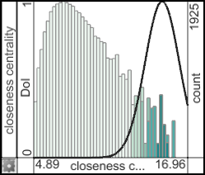
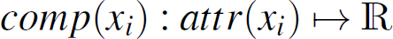
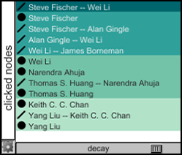
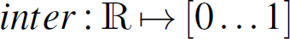
Uninteresting Nodes on Degree-of-Interest Measures
Detecting
Data Level (Filtering)
Specification Components
[slide courtesy of Steffen Hadlak]

Slide 12
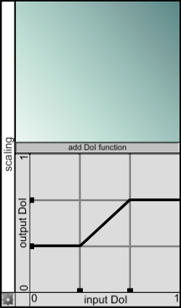
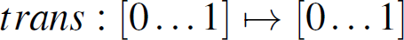
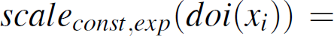
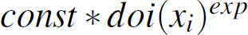
Uninteresting Nodes on Degree-of-Interest Measures
Detecting
Data Level (Filtering)
Transformation Components
[slide courtesy of Steffen Hadlak]

Slide 13
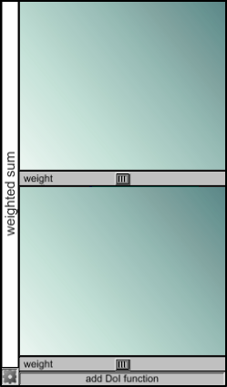
Uninteresting Nodes on Degree-of-Interest Measures
Detecting
Data Level (Filtering)
Combination Components
[slide courtesy of Steffen Hadlak]

Slide 14
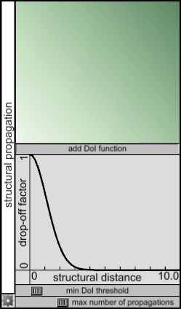
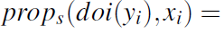
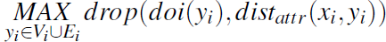
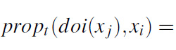
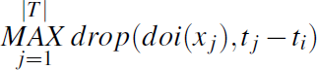
Uninteresting Nodes on Degree-of-Interest Measures
Detecting
Data Level (Filtering)
Propagation Components
[slide courtesy of Steffen Hadlak]

Slide 15
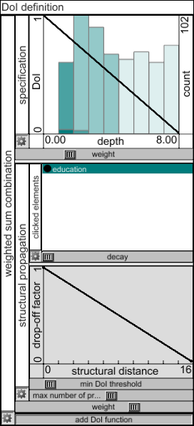
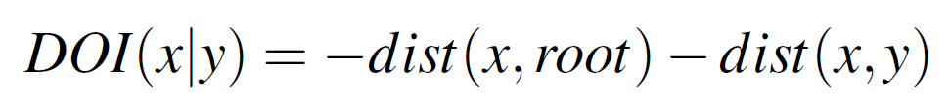
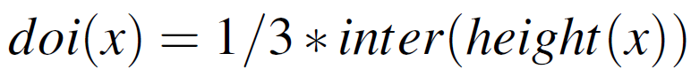
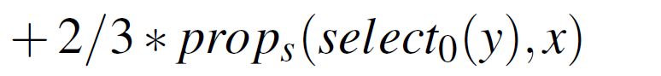
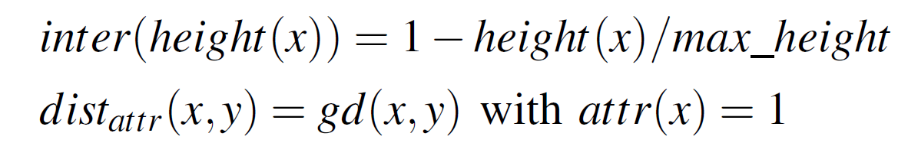
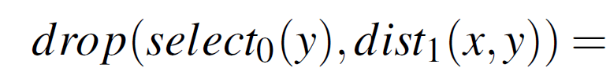
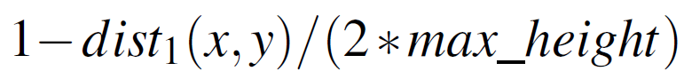
Uninteresting Nodes on Degree-of-Interest Measures
Detecting
Data Level (Filtering)
A Modular Furnas-like DoI
[image courtesy of Steffen Hadlak]

Slide 16
Redundant Nodes on Similarity + Clustering
Detecting
Data Level (Filtering)
Similarity can be defined in a number of spaces:
Topological space e.g., graph-theoretic distance of nodes
Attribute space e.g., Euclidean distance of attribute vectors
Temporal space e.g., length of time span separating nodes

Slide 17
Redundant Nodes on Similarity + Clustering
Detecting
Data Level (Filtering)
The principles of clustering are assumed as known.
Clustering challenges that arise in networks relate to its runtime complexity and semantics.

Slide 18
Redundant Nodes on Similarity + Clustering
Detecting
Data Level (Filtering)
Some simple preprocessing can resolve such clustering problems: e.g., cloning nodes to clarify semantics
[adapted from Abello et al. 2006]

Slide 19
Redundant Nodes on Similarity + Clustering
Detecting
Data Level (Filtering)
Some simple preprocessing can resolve such clustering problems: e.g., peeling to reduce runtime
Peripheral Forest gets grouped by trees having the same root
[adapted from Abello et al. 2006]

Slide 20
Uninteresting Nodes on Node Contraction
Reducing
Data Level (Filtering)
Node removal can disrupt network topology:
Node contraction maintains network topology:

Slide 21
Redundant Nodes on Node Set Substitution
Reducing
Data Level (Filtering)
Substitute each Cluster with a Cluster Representative
Centroids
Metanodes

Slide 22
with Reduced Node Sets on Thresholding
Interacting
Data Level (Filtering)
Adjust the removal of nodes by adjusting the Degree-of-Interest Threshold:
directly: set a threshold below which nodes are removed
indirectly: set a number N of nodes that shall remain, pick the N nodes with highest DoI values, remove the rest

Slide 23
with Reduced Node Sets on Thresholding
Interacting
Data Level (Filtering)
Adjust the clustering of nodes by adjusting the Similarity Threshold:
directly: set a threshold above which nodes are clustered
indirectly: set a number N of nodes/clusters that shall remain and cluster nodes with decreasing similarity values until N are left

Slide 24

with Reduced Node Sets on Thresholding
Interacting
Data Level (Filtering)
Adjust the clustering of nodes by adjusting the Similarity Threshold…
vanHam2004 - Small World Graphs.avi

Slide 25
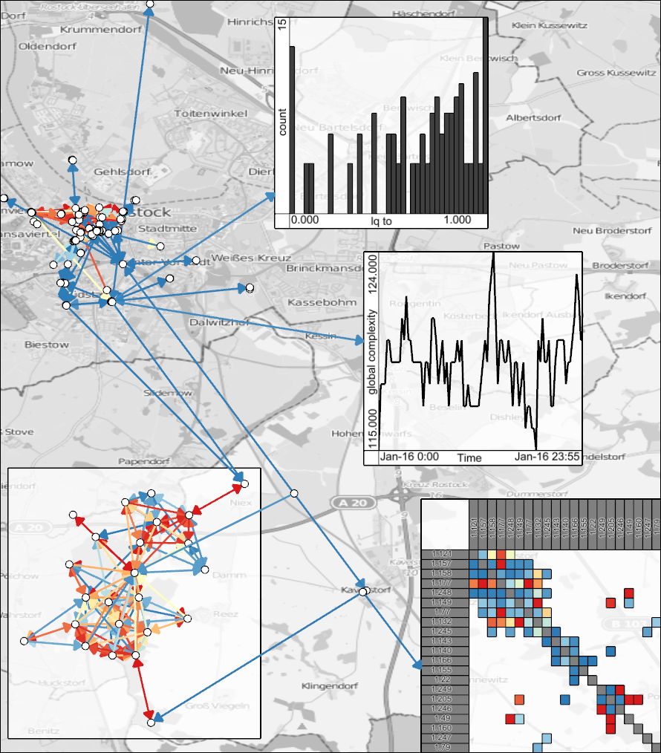
Geometry Level (Mapping)
Node Set Simplification on

Slide 26
Node Set Simplification on
Geometry Level (Mapping)
Two fundamental approaches:
Layout Generation: React to a large node set during the layout generation
Layout Readjustment: Detect clutter/dense areas in a given layout and simplify it accordingly
Notes:
Nodes != nodes

Slide 27
Generating Layouts on
Geometry Level (Mapping)
Make nodes very small and place them very close…
Example: Point-based Tree Layout [Schulz et al. 2011]
Schulz2009 - Pointbased (PacificVis).avi
Notes:
Nodes != nodes

Slide 28
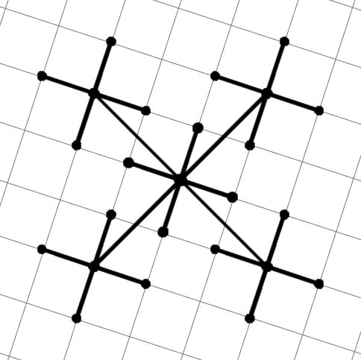
Generating Layouts on
Geometry Level (Mapping)
Why rotation by 27°? – Finally the answer…
The Setup:
2
1
SQRT(2²+1²)
Notes:
Nodes != nodes

Slide 29
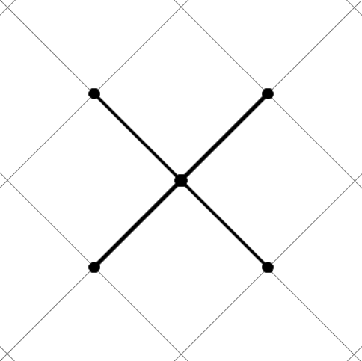
Generating Layouts on
Geometry Level (Mapping)
Why rotation by 27°? – Finally the answer…
The Scaling:
1/SQRT(5)
SQRT(5)
1
Notes:
Nodes != nodes

Slide 30
Generating Layouts on
Geometry Level (Mapping)
Why rotation by 27°? – Finally the answer…
The Rotation:
theta
opposite side hypotenuse
sin(θ) =
1
SQRT(5)
sin(θ) = 1 / SQRT(5)
θ = arcsin(1 / SQRT(5))
θ ≈ 27°
Notes:
Nodes != nodes

Slide 31
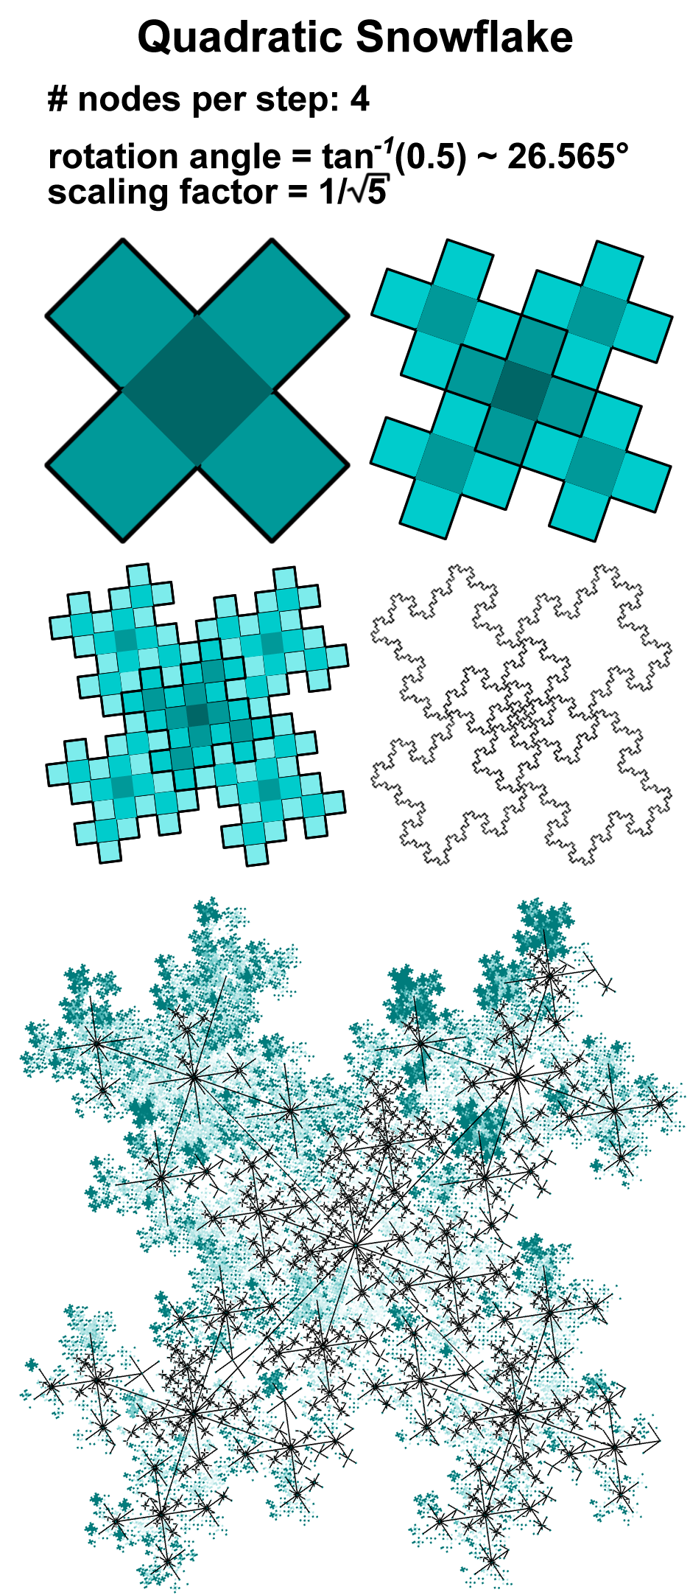
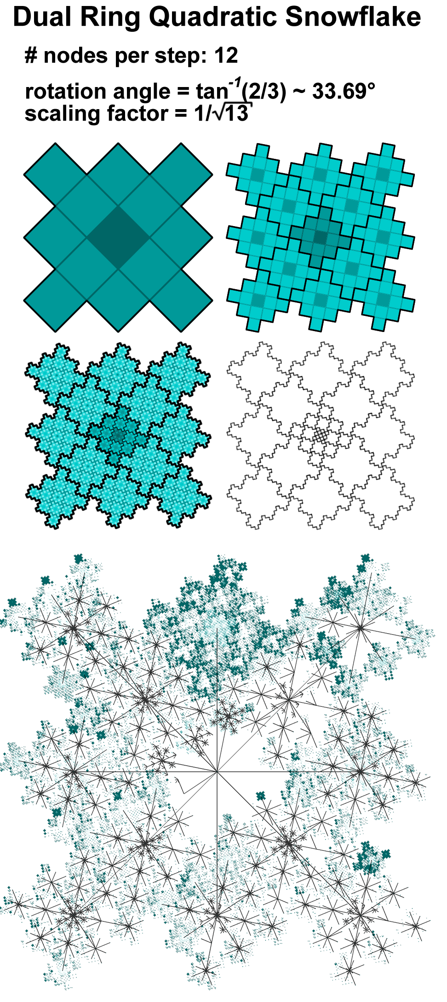
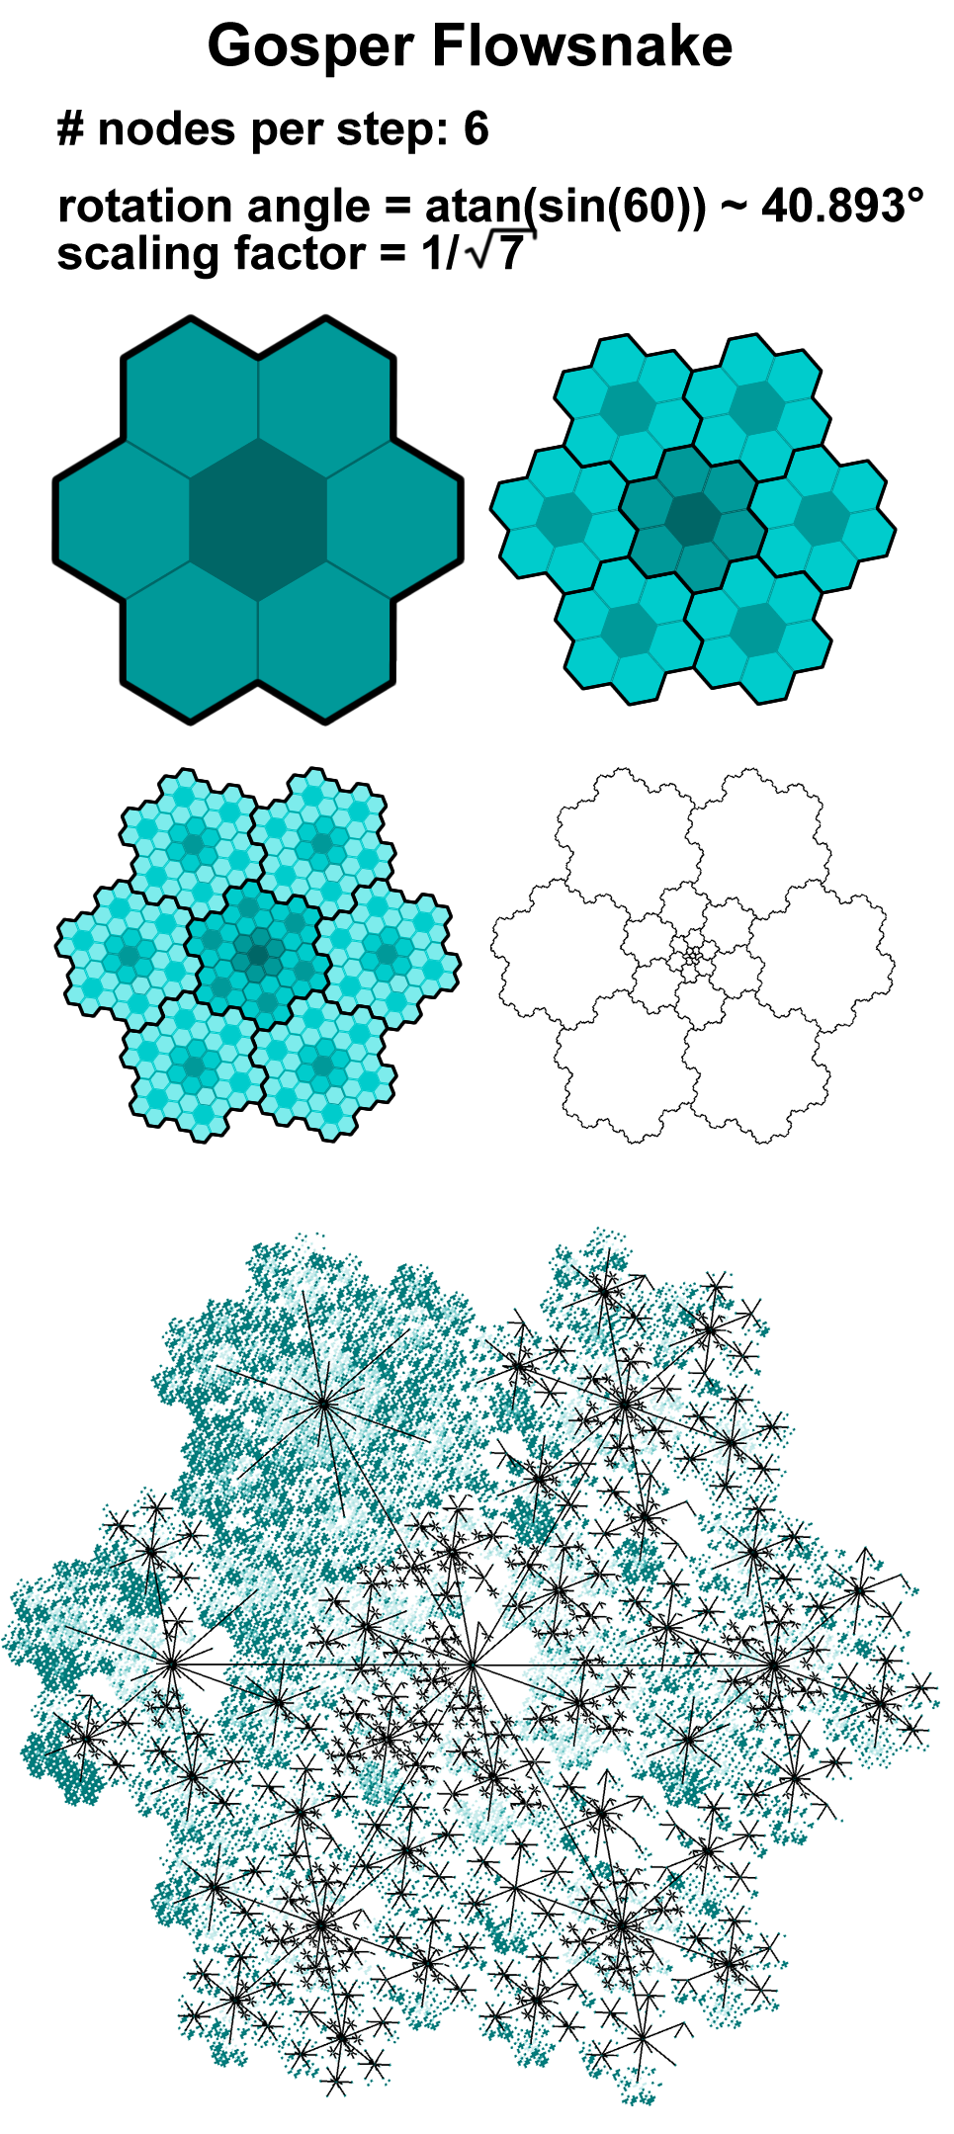
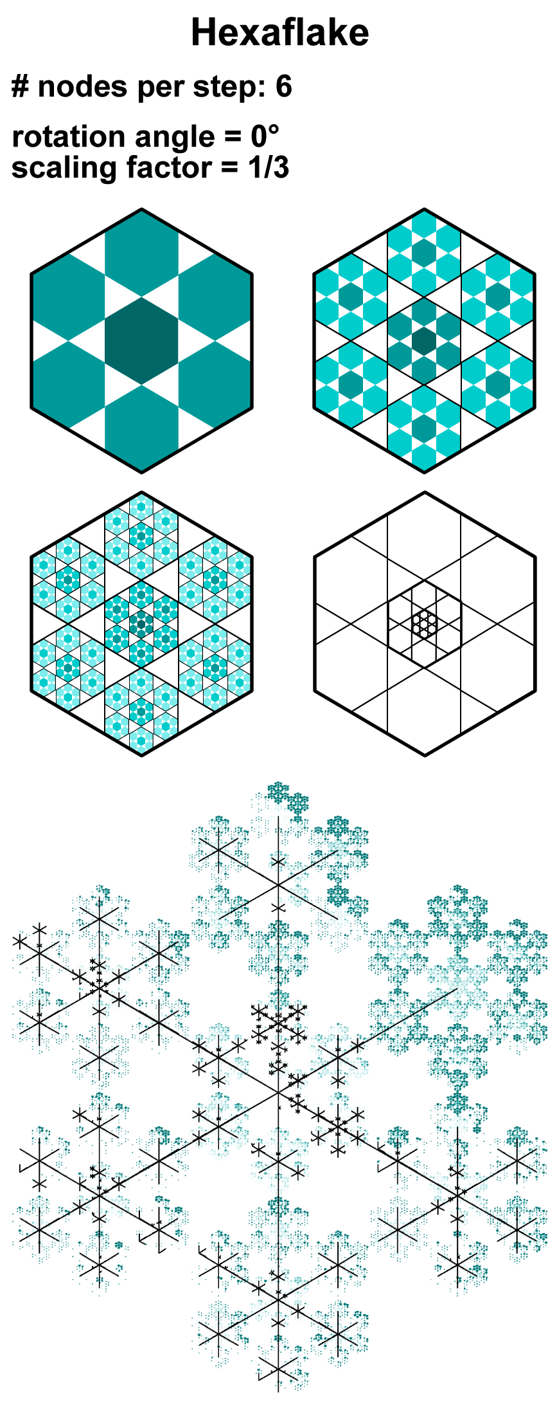
Generating Layouts on
Geometry Level (Mapping)
This also works for other scaling factors/angles:
[images courtesy of Steffen Hadlak]
Notes:
Nodes != nodes

Slide 32
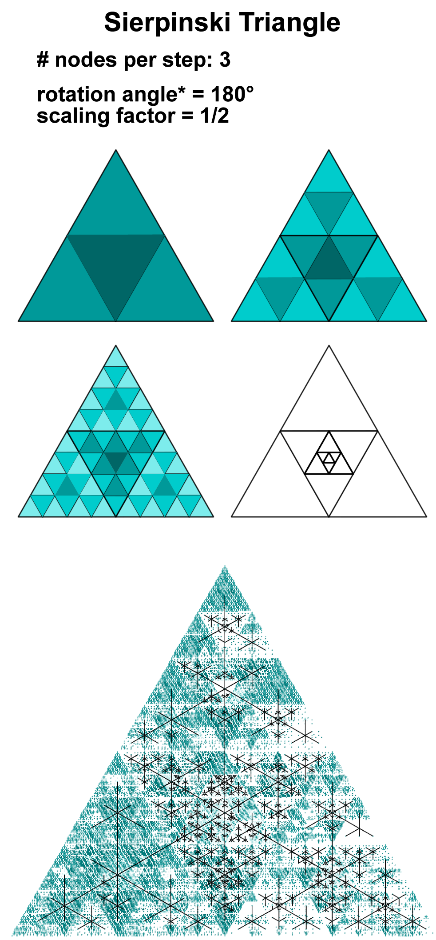
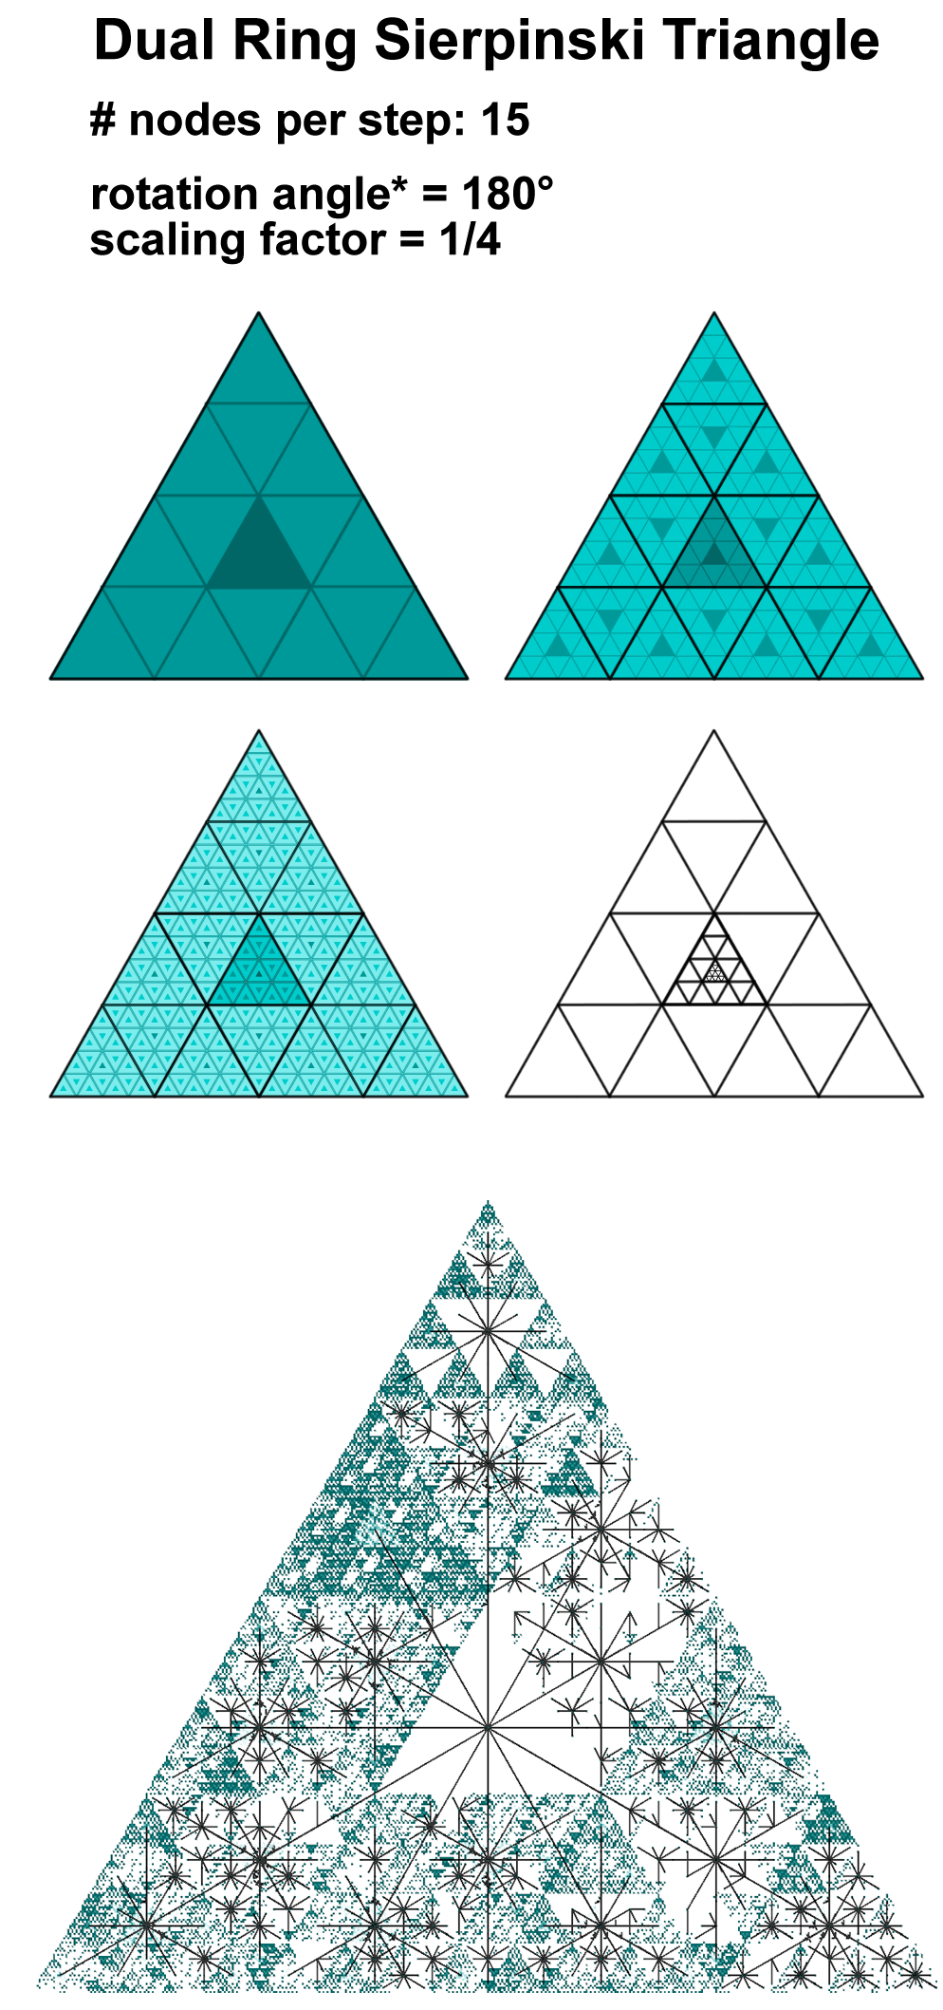
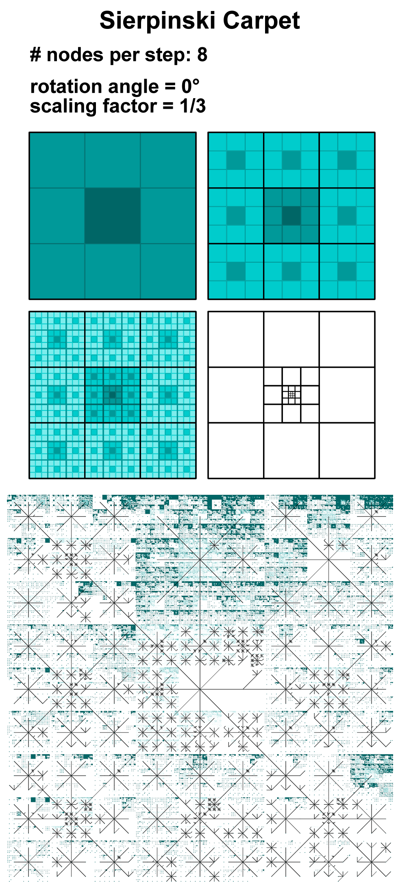
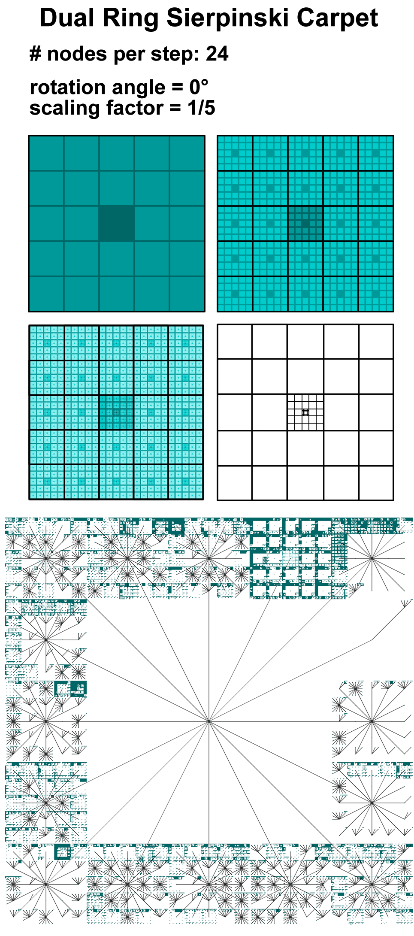
Generating Layouts on
Geometry Level (Mapping)
This also works for other scaling factors:
[images courtesy of Steffen Hadlak]
Notes:
Nodes != nodes

Slide 33
Generating Layouts on DoI-based Layout
Geometry Level (Mapping)
Network Simplification Examples
WHEN?
Data Level (Filtering)
Geometry Level (Mapping)
Image Level (Rendering)
Detection
Compute DoI values for elements
Shift clutter from high DoI nodes to low DoI nodes
HOW?
Reduction
Interaction
Select node to adjust focus
Notes:
Nodes != nodes

Slide 34
Generating Layouts on DoI-based Layout
Geometry Level (Mapping)
Shifting is done by using the DoI values as forces in a force-directed layout.
But there are many more uses for DoI values:
Pinning weights in a dynamic layout
Labeling priority
Saturation of color-coding
…and even Pseudohaptics
Notes:
Nodes != nodes

Slide 35
Generating Layouts on Similarity/Cluster-based Layout
Geometry Level (Mapping)
Network Simplification Examples
WHEN?
Data Level (Filtering)
Geometry Level (Mapping)
Image Level (Rendering)
Detection
Compute similarity and clusters
Place clustered nodes close to each other
HOW?
Reduction
Interaction
Select node for unbalanced Drill-down/Roll-up
Notes:
Nodes != nodes

Slide 36
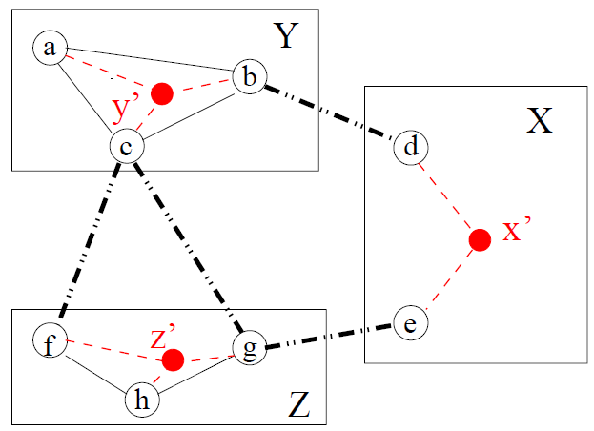
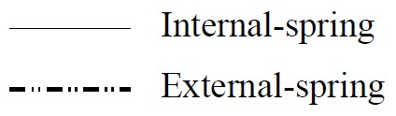
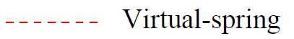
Generating Layouts on Similarity/Cluster-based Layout
Geometry Level (Mapping)
Placing clustered nodes close to each other can be achieved by a multilevel layout approach:
[image taken from Eades+Huang 2000]
Notes:
Nodes != nodes

Slide 37
Generating Layouts on Similarity/Cluster-based Layout
Geometry Level (Mapping)
Note: The layout should focus on the node aspect according to which the network was clustered!
[Eades+Huang 2000]
[Aris+Shneiderman 2007]
Notes:
Nodes != nodes

Slide 38
Readjusted Layout on
Geometry Level (Mapping)
If nodes produce clutter in a layout, there are three ways to counter that on geometry level:
Distribute the nodes – e.g., overlap removal
Remove the nodes – e.g., layout coarsening
Abstract the nodes – e.g., use of metanodes
Notes:
Nodes != nodes

Slide 39
Readjusting Layouts on
Geometry Level (Mapping)
Distribution: Generalized Scatter Plots [Keim et al. 2010] displacement + distortion

Slide 40
Readjusting Layouts on
Geometry Level (Mapping)
Distribution: Generalized Scatter Plots [Keim et al. 2010] displacement + distortion

Slide 41
Readjusting Layouts on
Geometry Level (Mapping)
Distribution: Generalized Scatter Plots [Keim et al. 2010] displacement + distortion

Slide 42
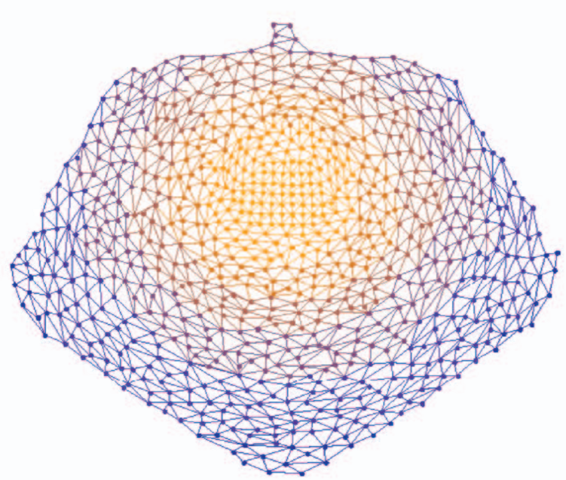
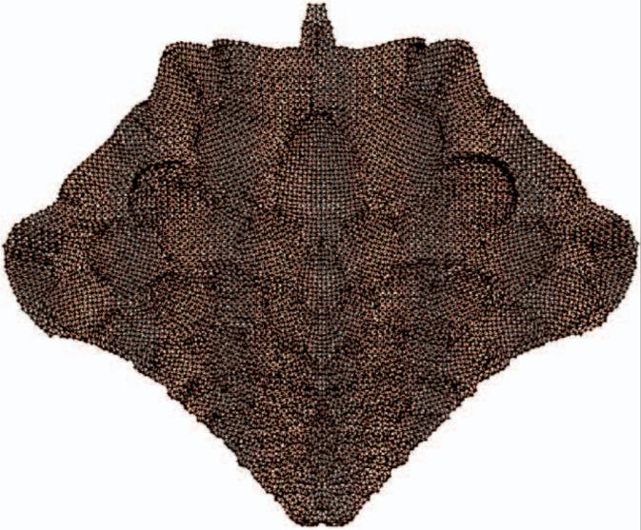
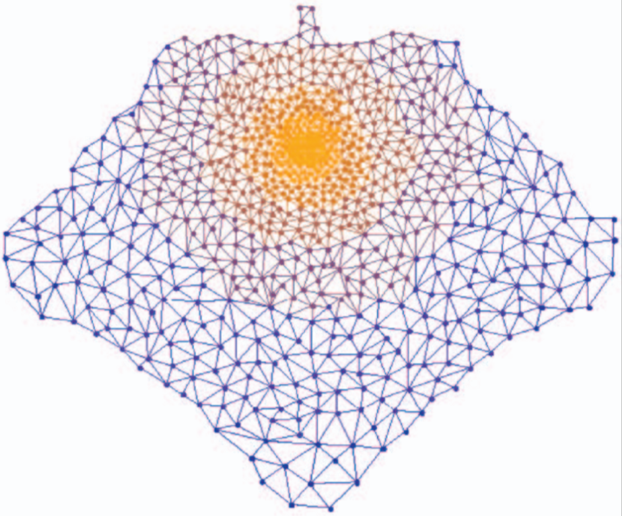
Readjusting Layouts on
Geometry Level (Mapping)
Coarsening: Topological Fisheye [Ganser et al. 2005]
Original: Crack Graph V= 10240 E= 30380
LOD Coarsening: fine-grained at focus node, coarse-grained the further away
Radial Distortion to achieve uniform node density

Slide 43
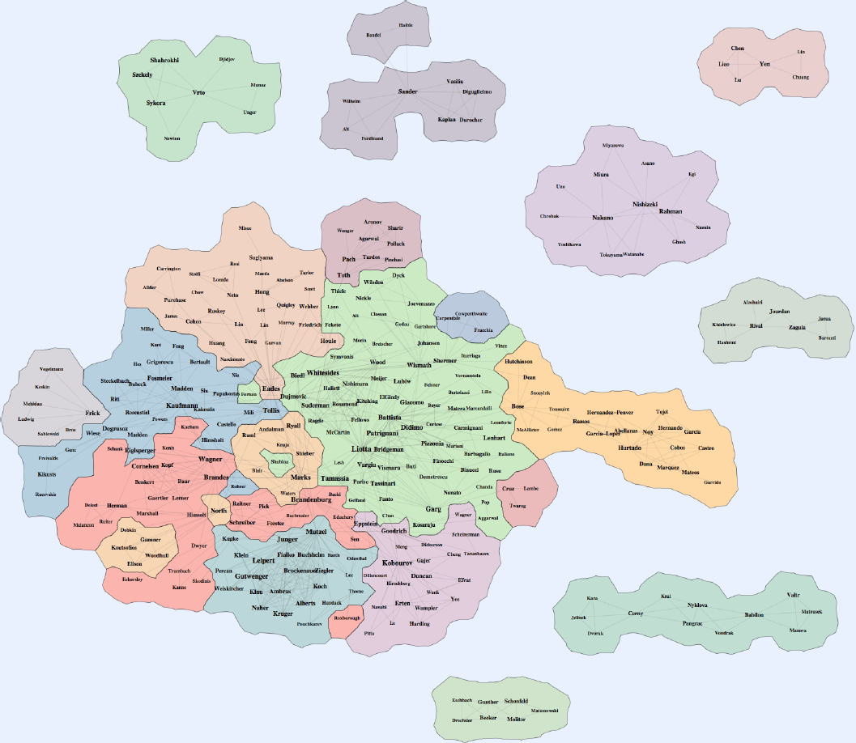
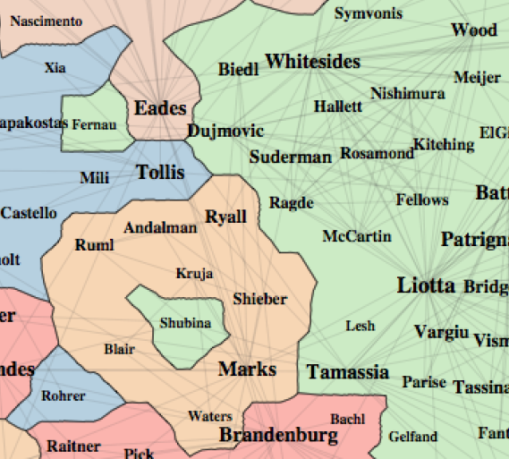
Readjusting Layouts on Cluster-based Readjustment
Geometry Level (Mapping)
2D Abstraction: Gmap [Gansner et al. 2010]
Notes:
Nodes != nodes

Slide 44
Readjusting Layouts on Cluster-based Readjustment
Geometry Level (Mapping)
3D Abstraction: Graph Cluster Surfaces [Balzer+Deussen 2007]
Notes:
Nodes != nodes

Slide 45
Readjusting Layouts on Interactive Readjustment
Geometry Level (Mapping)
In situ Visualization [Hadlak et al. 2011]
Hadlak2011 - InSitu 1.avi
Notes:
Nodes != nodes

Slide 46
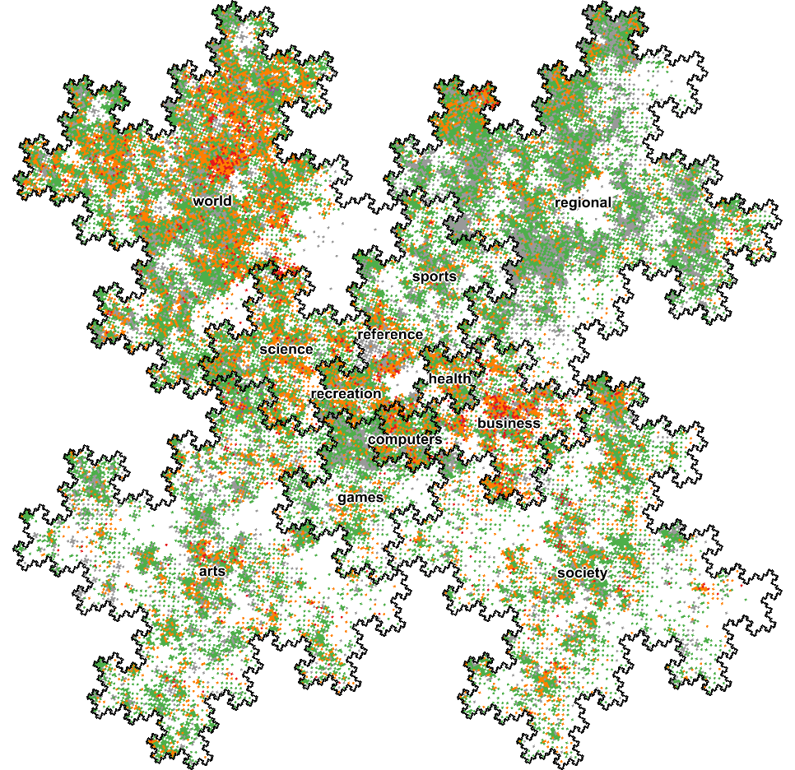
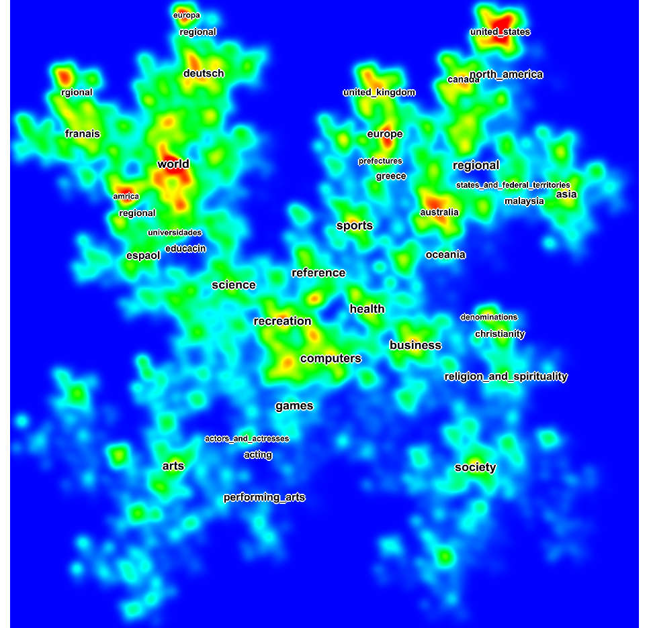
Image Level (Rendering)
Node Set Simplification on

Slide 47
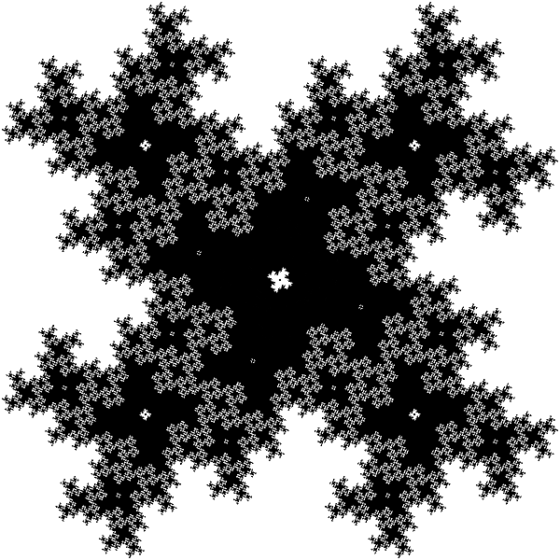
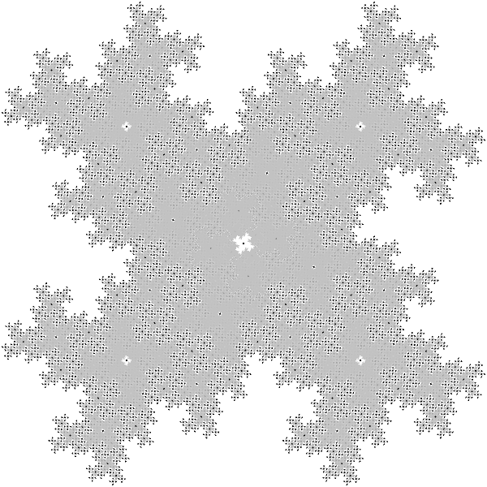
Clutter on
Reducing
Image Level (Rendering)
Idea: Normalization Example: Lightness Adaptation
the same regular, balanced tree
without adaptation
with adaptation
Notes:
Nodes != nodes

Slide 48
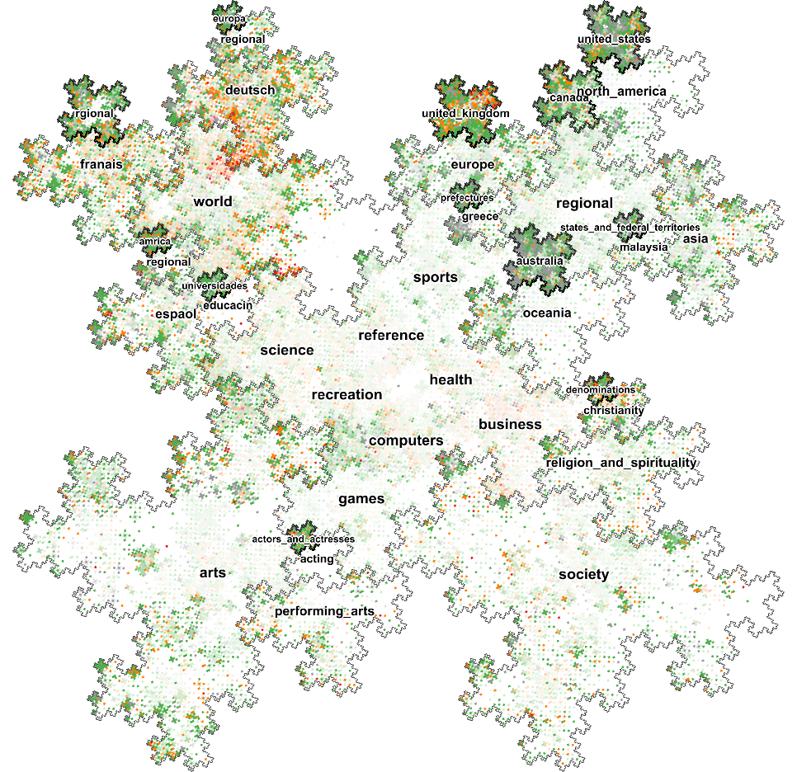
Clutter on
Reducing
Image Level (Rendering)
without adaptation
with adaptation
Notes:
Nodes != nodes

Slide 49
Notes:
Nodes != nodes

Slide 50
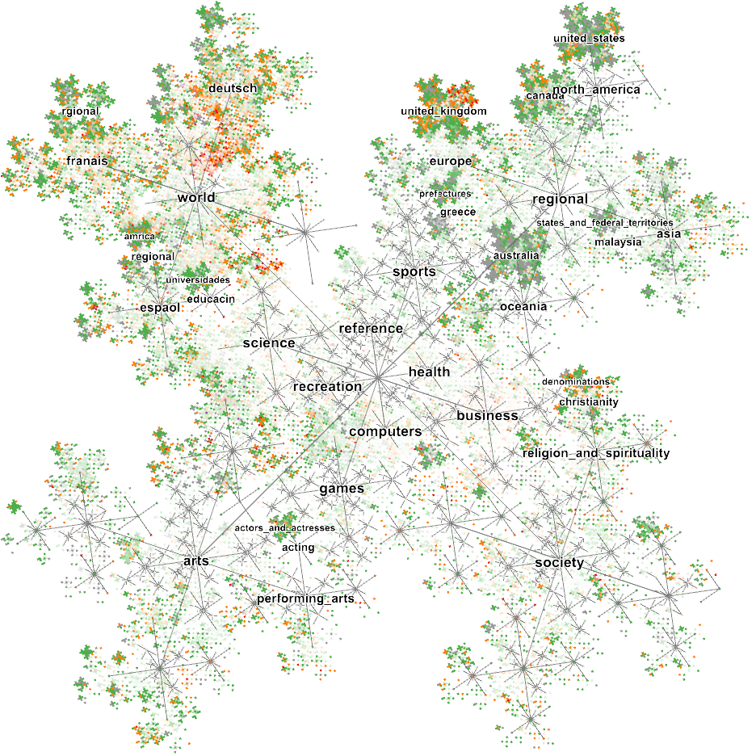
Notes:
Nodes != nodes

Slide 51
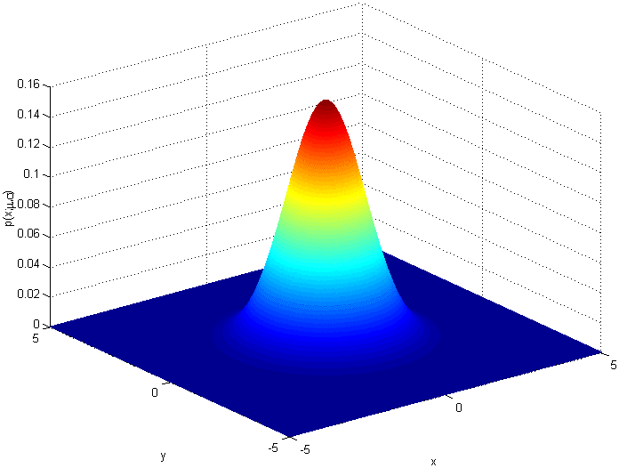
with Clutter on
Interacting
Image Level (Rendering)
Example: Graph Splatting [van Liere+de Leeuw 2003]
0. Prepare an array M(i,j) of the size of the drawing area
For each node plotted at position (x,y):
1. compute Gaussian centered at (x,y) with a given variance v
2. add to each cell of M(i,j) the value of the Gaussian at that position
radially symmetric Gaussian distribution
Notes:
Nodes != nodes

Slide 52
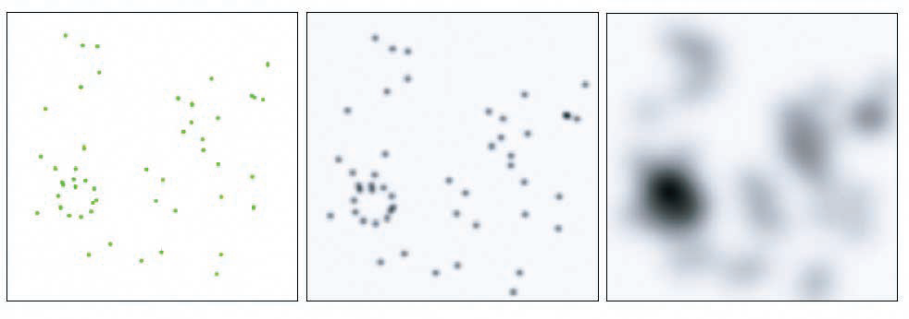
with Clutter on
Interacting
Image Level (Rendering)
Example: Graph Splatting [van Liere+de Leeuw 2003]
Effect of different variances: left = original layout, middle = low variance, right = high variance
Notes:
Nodes != nodes

Slide 53
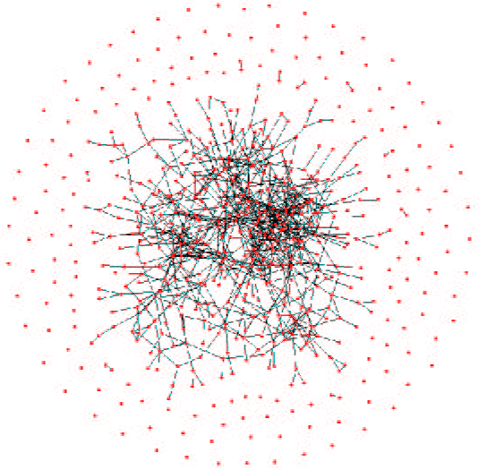

with Clutter on
Interacting
Image Level (Rendering)
region of high node density
Notes:
Nodes != nodes

Slide 54

with Clutter on
Interacting
Image Level (Rendering)
σ = 0.001
[images courtesy of Steffen Hadlak]
Notes:
Nodes != nodes

Slide 55

with Clutter on
Interacting
Image Level (Rendering)
σ = 0.002
[images courtesy of Steffen Hadlak]
Notes:
Nodes != nodes

Slide 56

with Clutter on
Interacting
Image Level (Rendering)
σ = 0.004
[images courtesy of Steffen Hadlak]
Notes:
Nodes != nodes

Slide 57

with Clutter on
Interacting
Image Level (Rendering)
σ = 0.015
[images courtesy of Steffen Hadlak]
Notes:
Nodes != nodes

Slide 58

with Clutter on
Interacting
Image Level (Rendering)
σ = 0.020
[images courtesy of Steffen Hadlak]
Notes:
Nodes != nodes

Slide 59
with Clutter on
Interacting
Image Level (Rendering)
Example: Graph Splatting [van Liere+de Leeuw 2003]
Schulz2011 - Pointbased (TVCG).avi
Notes:
Nodes != nodes

Slide 60

with Clutter on
Interacting
Image Level (Rendering)
all nodes are equal
[images courtesy of Steffen Hadlak]
Notes:
Nodes != nodes

Slide 61

with Clutter on
Interacting
Image Level (Rendering)
nodes are weighted by their depth
[images courtesy of Steffen Hadlak]
Notes:
Nodes != nodes

Slide 62

with Clutter on
Interacting
Image Level (Rendering)
nodes are weighted by their # of siblings
[images courtesy of Steffen Hadlak]
Notes:
Nodes != nodes

Slide 63

Summary
Node Set Simplification

Slide 64
Data Level (Filtering)
Geometry Level (Mapping)
Image Level (Rendering)
Data Generation
Data Readjustment
Layout Generation
Layout Readjustment
Image Generation
Image Readjust-ment
Reduction: Sampling
Reduction: Dense Layout
Reduction: Distribution
Detection: Overplotting
Detection: DoI metric
Reduction: Normalization
Interest-based Methods
Reduction: Clutter the uninteresting
Clutter Reduction w/o Node Reduction
Reduction: Contraction
Reduction: Coarsening
Detection: Similarity/ Cluster
Reduction: Abstraction
Redundancy-based Methods
Reduction: Clutter the similar
Reduction: Substitution
Interaction: Thresholding
Interaction: Select Focus
Interaction: Splatting

